Slide 1
Research and Innovation STAR @ CIn-UFPE Marcelo d’Amorim – damorim@cin.ufpe.br
December 2019

Slide 2
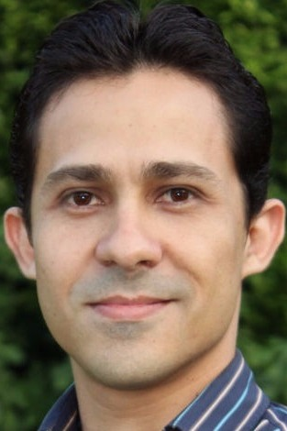

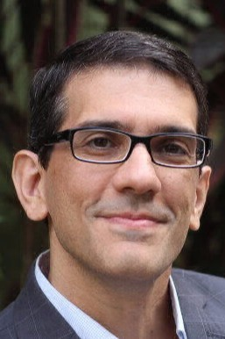
STAR
Software Testing and Analysis Research
Breno
Leopoldo
Marcelo

Slide 3
Goal
Prevent, discover, diagnose, and repair software bugs and vulnerabilities to improve software quality

Slide 4
Achievements
Found, reported, and fixed hundreds of bugs!
Developed several popular open-source tools
Attracted funding from diverse sources (e.g., Microsoft, Facebook, NSF, etc.)
Published research in highly-selective venues

Slide 5
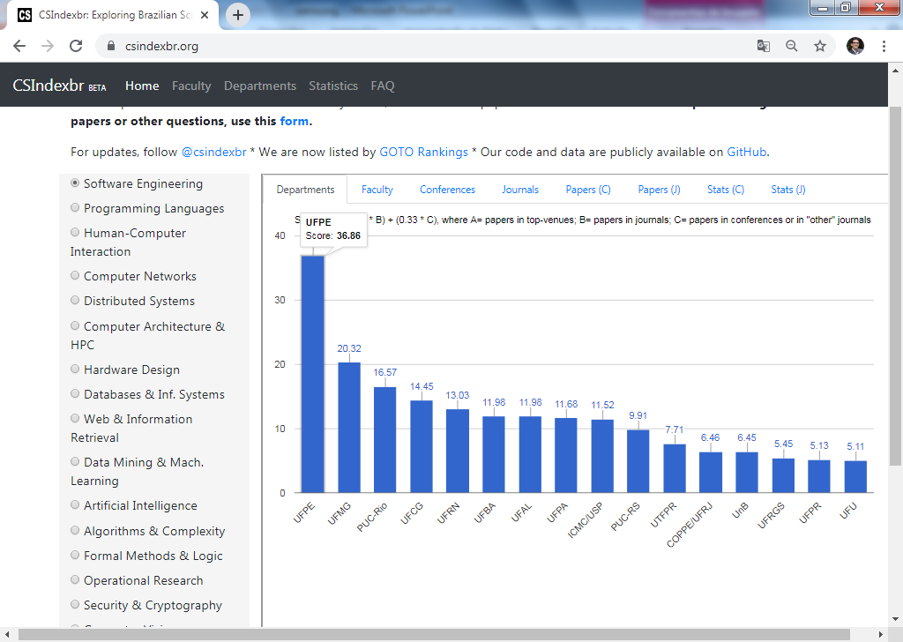
Leaders in SE research in Brazil and South America
csindexbr.org
csrankings.org

Slide 6
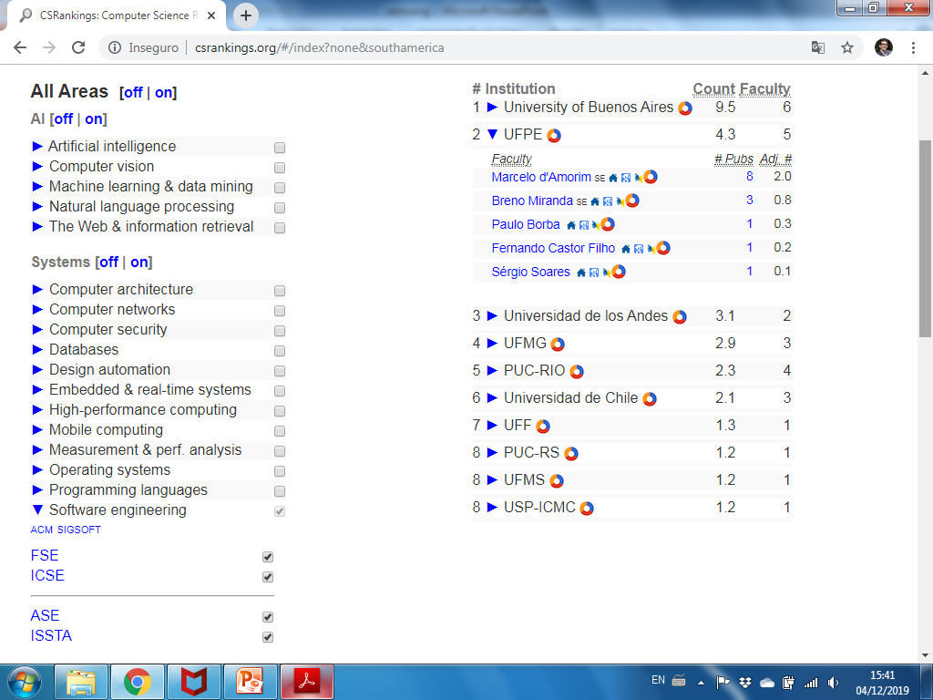
Leaders in SE research in Brazil and South America
csindexbr.org
csrankings.org

Slide 7
case: Security Testing
Part of a joint US/Brazil Cyber-Security project. Funded by NSF/RNP ($300K).

Slide 8
Security Testing
IoT Security
Network Intrusion Detection
Generation of Drivers to Fuzz

Slide 9

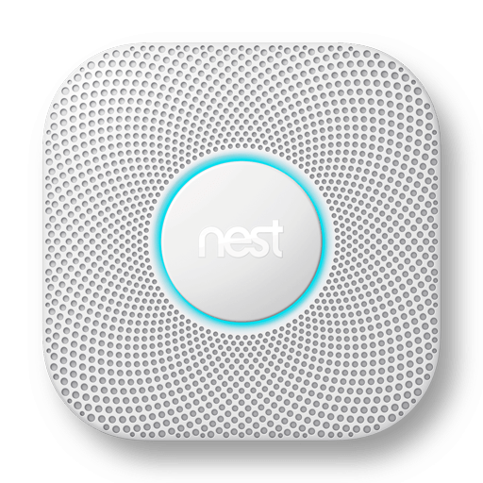

Internet of Things (IoT) Security
Context:
Smart Home

Slide 10
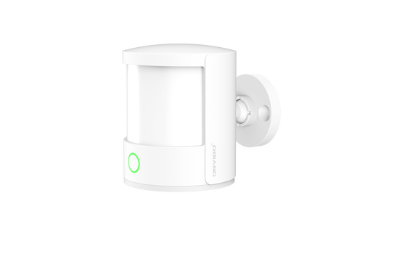
Internet of Things (IoT)
Lots of very simple (and cheap) devices in the market
Bulb
Presence
Smoke

Slide 11

Internet of Things (IoT)
Often devices are resource-constrained …as they are relatively cheap (built for the masses)
Bulb
Presence
Smoke

Slide 12
Internet of Things (IoT)
Often devices are resource-constrained …as they are relatively cheap (built for the masses)
Challenging to implement robust security mechanisms.
Bulb
Presence
Smoke

Slide 13
What we did
Analyzed code of apps of various IoT devices looking for possible security issues
Used both static and dynamic analysis tools

Slide 14
What we found
Around 50% of apps we analyzed were problematic
Passwords expressed in code
Weak crypto algorithms
etc.

Slide 15
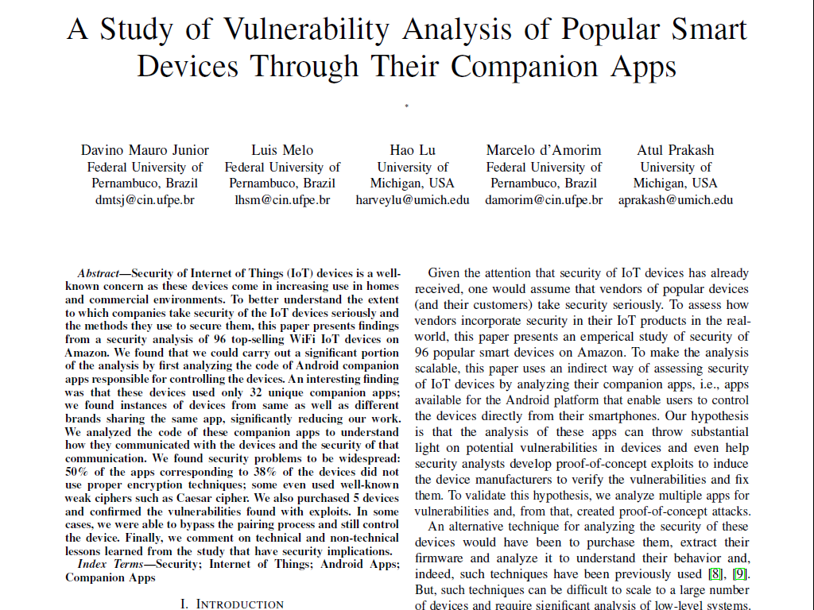
In the press…
SafeThings2019 (part of Oakland Security)

Slide 16
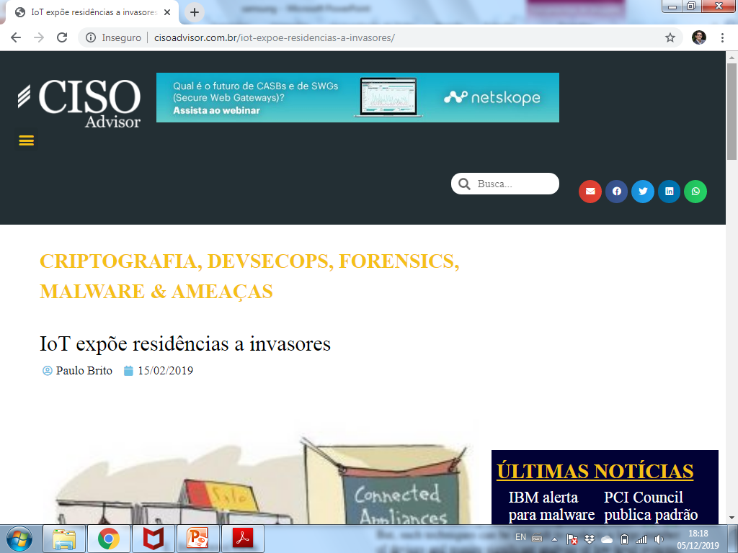
http://www.cisoadvisor.com.br/iot-expoe-residencias-a-invasores/

Slide 17
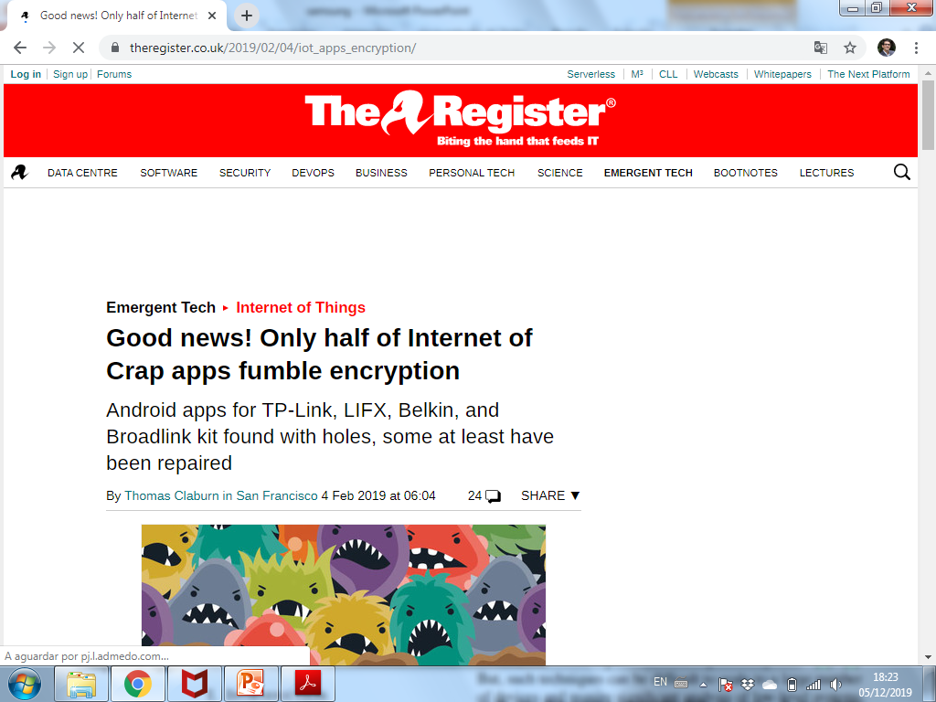
http://www.cisoadvisor.com.br/iot-expoe-residencias-a-invasores/
https://www.theregister.co.uk/2019/02/04/iot_apps_encryption/
SafeThings2019 (part of Oakland Security)

Slide 18
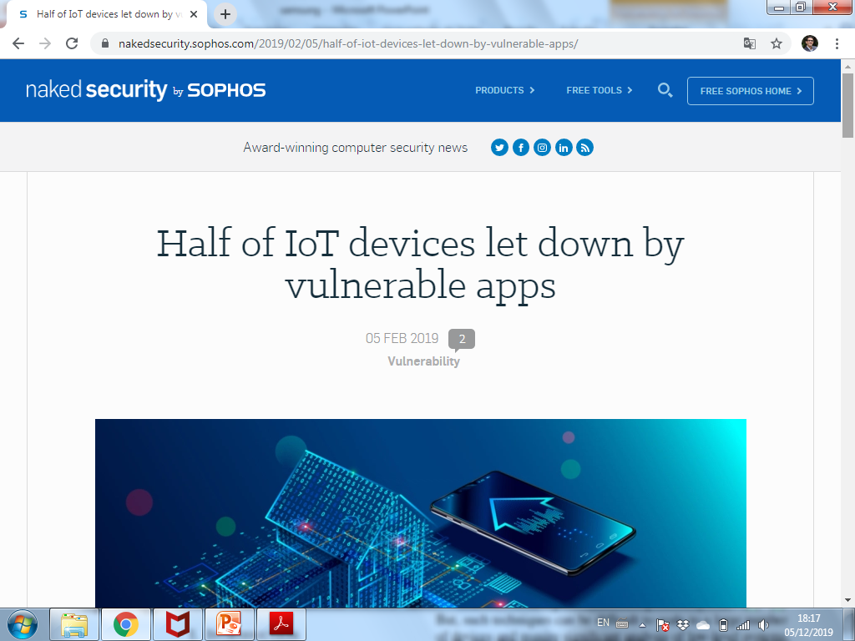
http://www.cisoadvisor.com.br/iot-expoe-residencias-a-invasores/
https://www.theregister.co.uk/2019/02/04/iot_apps_encryption/
https://nakedsecurity.sophos.com/2019/02/05/half-of-iot-devices-let-down-by-vulnerable-apps/
https://www.techradar.com/news/insecure-apps-put-half-of-iot-devices-at-risk
SafeThings2019 (part of Oakland Security)

Slide 19
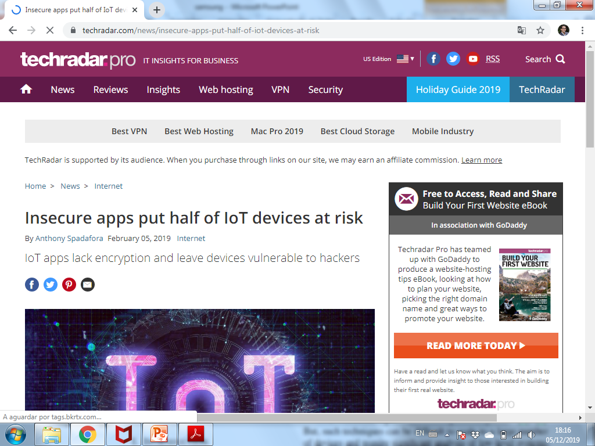
In the press…
http://www.cisoadvisor.com.br/iot-expoe-residencias-a-invasores/
https://www.theregister.co.uk/2019/02/04/iot_apps_encryption/
https://nakedsecurity.sophos.com/2019/02/05/half-of-iot-devices-let-down-by-vulnerable-apps/
https://www.techradar.com/news/insecure-apps-put-half-of-iot-devices-at-risk

Slide 20
Security Testing
IoT Security
Network Intrusion Detection (ongoing)
Generation of Drivers to Fuzz

Slide 21
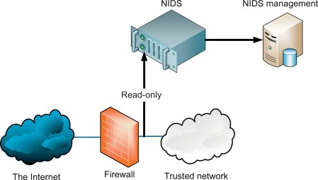

Network Intrusion Detection Systems (NIDS)
Port scan
Spoofing(ARP,IP,DNS)
TCP SYN flood
Data modification
…

Slide 22
Two main approaches
Signature-based
Anomaly-based

Slide 23


Two main approaches
Signature-based
Anomaly-based
Most popular open-source NIDS

Slide 24
How it works…
Security expert specifies attack pattern
NIDS checks traffic
The system or sys admin takes action

Slide 25


Basic Rule
Preventing SQL Injection Attack
alert tcp any any -> any 80 (msg: "Error Based SQL Injection Detected"; content: "%27" ; sid:100000011; )
https://www.hackingarticles.in/detect-sql-injection-attack-using-snort-ids/
Single quote

Slide 26
Rule Format
alert tcp any any -> any 80 (msg: "Error Based SQL Injection Detected"; content: "%27" ; sid:100000011; )
Action: pass, drop, reject, alert
Header: protocol source-address port [ -> or <-> ] target-address port
Rule Options: …
https://suricata.readthedocs.io/en/suricata-4.1.4/rules/intro.html

Slide 27
Observations
Rules are based on heuristics
Hundreds of such rules exist (for Suricata: ~200 official, thousands non-official)
They can get very confusing!

Slide 28
Observations
alert tcp $EXTERNAL_NET any -> $HOME_NET any (msg:"ET SCAN NMAP -sS window 2048"; fragbits:!D; dsize:0; flags:S,12; ack:0; window:2048; threshold: type both, track by_dst, count 1, seconds 60; reference:url,doc.emergingthreats.net/2000537; classtype:attempted-recon; sid:2000537; rev:8; metadata:created_at 2010_07_30, updated_at 2010_07_30;)
Rules are based on heuristics
Hundreds of such rules exist (for Suricata: ~200 official, thousands non-official)
They can get very confusing!
Source: https://security.stackexchange.com/questions/188021/suricata-nmap-scan-does-not-match-rules

Slide 29
Problem
It is challenging for maintainer to keep up with the pace of attackers

Slide 30
Our Approach
Synthesize rules from traffic (both benign and malicious) and observations from existing rules
Plausible rules
Ranked list of plausible rules
Traffic
Synthesize
Rank
Existing rules
Exhaustive search
Learning

Slide 31
Security Testing
IoT Security
Network Intrusion Detection
Generation of Drivers to Fuzz (ongoing)

Slide 32
Other Areas of Interest
Testing Configurable Systems
Regression Testing
Automated Debugging

Slide 33
Research and Innovation STAR @ CIn-UFPE Marcelo d’Amorim – damorim@cin.ufpe.br
More info at cin.ufpe.br/~damorim
December 2019

